Slide 1


Electrical Distribution System Power Characteristics
Ship Electrical Distribution System Design
Revision of September 23, 2026
Dr. Norbert Doerry
http://doerry.org/norbert/MarineElectricalPowerSystems/index.htm
© 2026 by Norbert Doerry
This work is licensed via: CC BY 4.0 (https://creativecommons.org/)

Slide 2
Essential Questions
What are the principal features of a primary bus, distribution bus, secondary bus, and special bus? | Understand
What are the sources of power quality requirements? | Understand
What is Quality of Service? | Understand
What terms (and what do they mean) are used to describe power quality and quality of service? | Understand

Slide 3
Characteristics of shipboard power systems
(As compared to terrestrial systems)
Frequency is not a constant
Lack of time scale separation
Load sharing instead of power scheduling
Short electrical distances
Load dynamics may be important
Tighter control
Ungrounded or high-resistance grounded systems
Physical environment

Slide 4
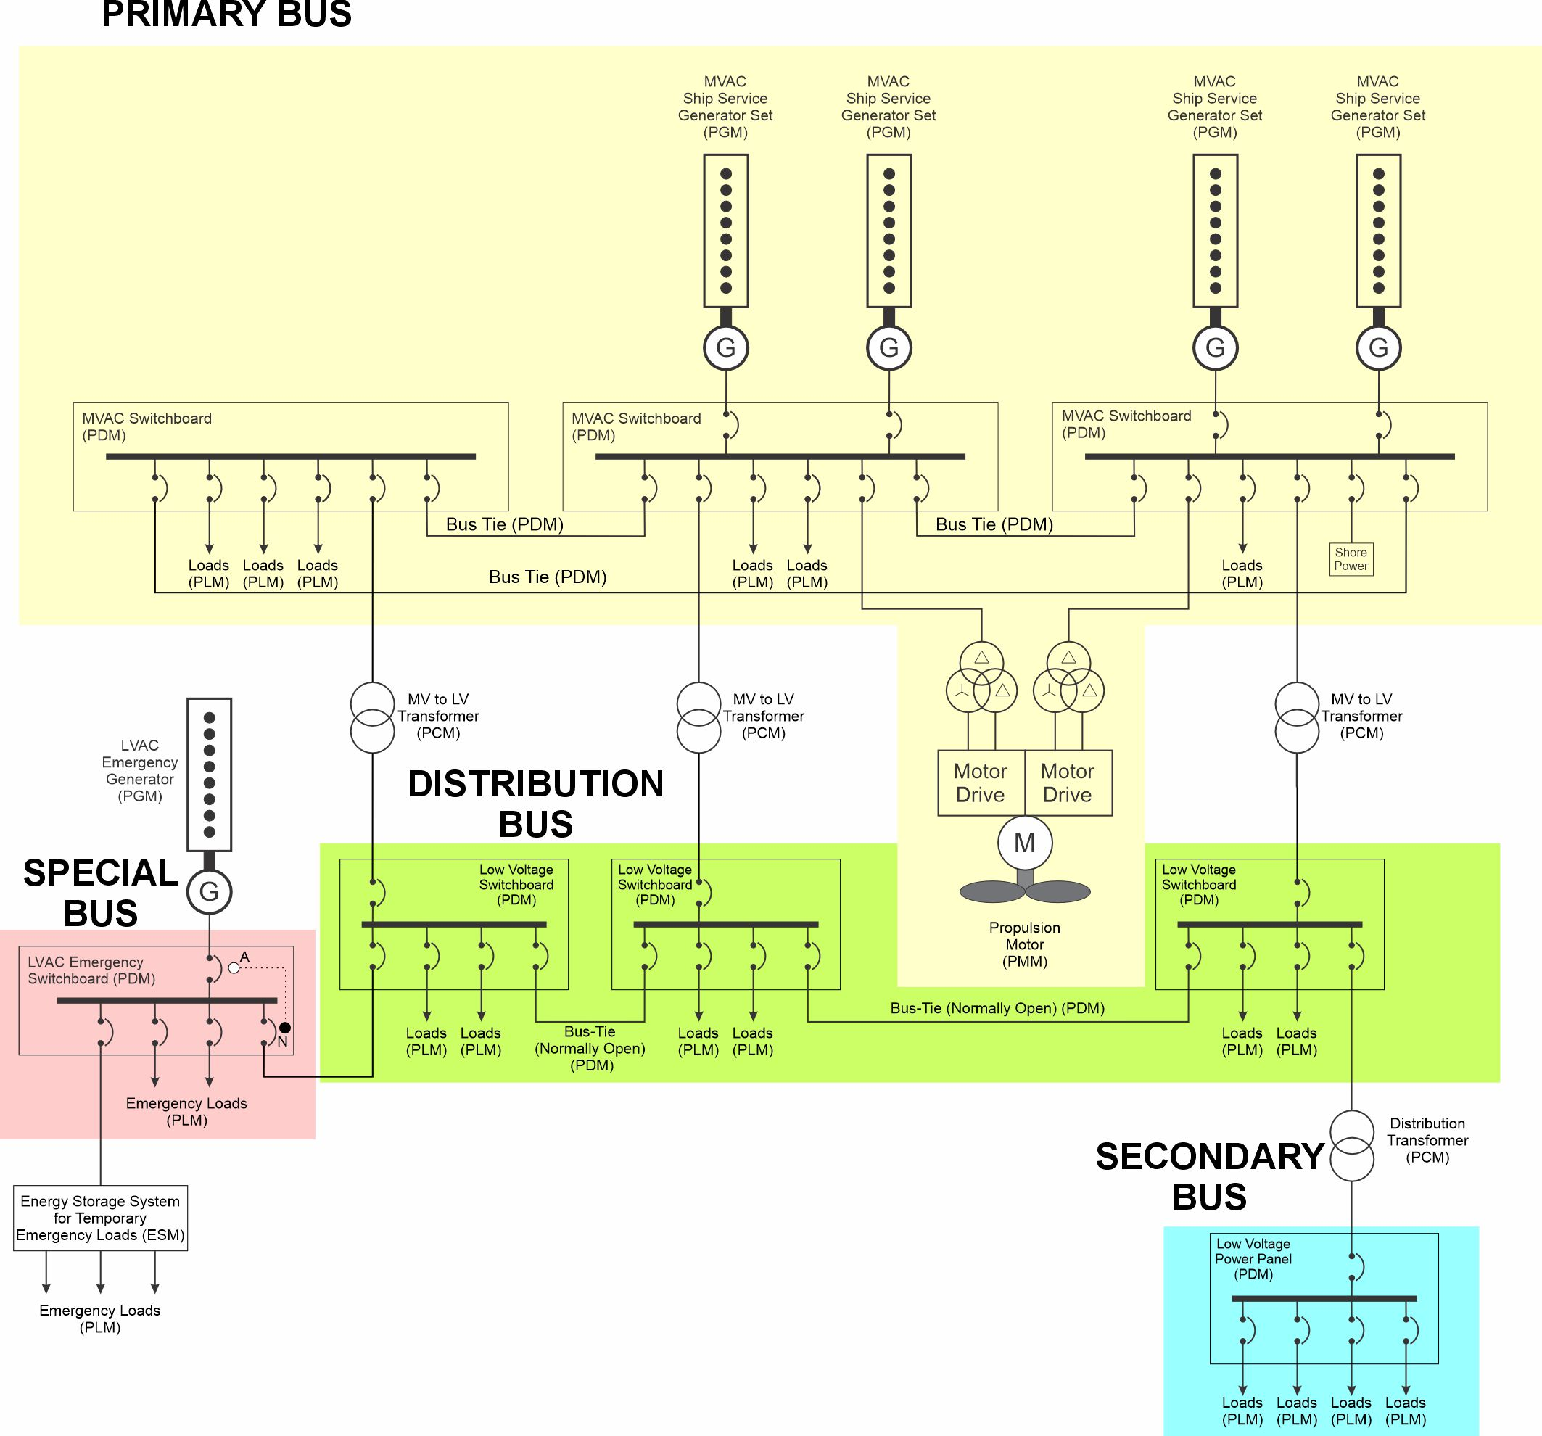
Primary Bus
IEEE Std 45.1
A primary bus is a term reserved for an ac or dc bus with a nominal system voltage greater than 1000 V
A primary bus may be implemented as multiple buses for redundancy, criticality, or safety.
A primary bus usually is only directly connected to a few large loads; the majority of the loads are powered from other buses that connect to the primary bus via power conversion equipment (e.g., transformers, solid-state power converters
Standard nominal system voltages
  AC: 3.3 kV; 4.16 kV; 6.6 kV; 11 kV; 13.8 kV
  Shore power connections defined for 6.6 kV and 11 kV
  DC: 1.5 kV; 3 kV; 6 kV; 12 kV; 18 kV; 24 kV; 30 kV

Slide 5
Distribution Bus
IEEE Std 45.1
A distribution bus provides power to loads throughout a ship or a zone.
Multiple distribution buses may be utilized as necessary for the vessel design.
Distribution buses typically support nominal system voltages between 400 V and 1000 V
Standard nominal system voltages
  AC: 400 V; 450 V; 480 V; 600 V; 690 V.
  DC: 600 V; 650 V; 700 V; 750 V; 1000
  USN: AC 440 V; DC 850 V

Slide 6
Secondary Bus
IEEE Std 45.1
A secondary bus provides electrical power with a nominal system voltage typically no greater than 400 V directly to
  equipment,
  appliances, or
  appliance outlets.
Standard nominal system voltages
  AC: 120 V; 208 V; 230 V; 240 V; 400 V
  DC: 110 V, 220 V, 375 V
  USN: AC 115 V; 200 V

Slide 7
Special Bus
IEEE Std 45.1
A special bus provides power for unique purposes such as medical use, control system power, special control, or propulsion.

Slide 8
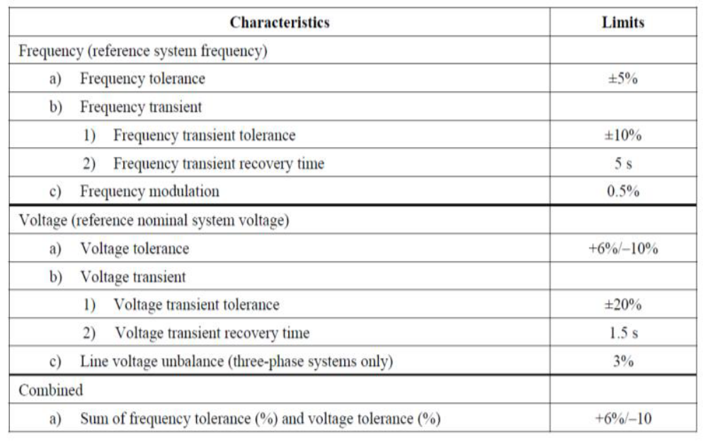
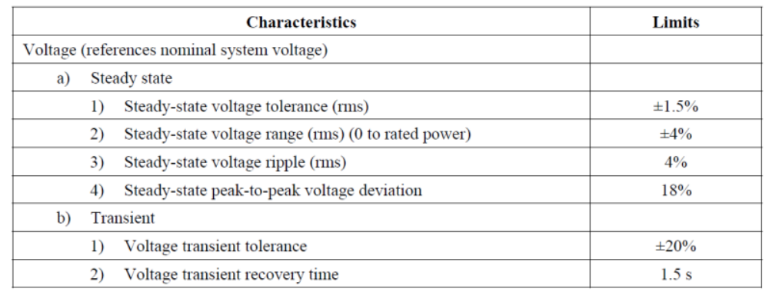
IEEE 45.1 Power Quality
AC Power
Provides definitions for every term
Additional ac requirements
  “The total waveform distortion (TWD) of the voltage at the switchboard, load center, or power panel directly connected to a load should not exceed 8% and any single frequency component of the voltage waveform should not exceed 5%. “
  “If the TWD of the voltage waveform exceeds 5% or any single frequency component exceeds 3%, equipment specifications should include the expected maximum values for TWD and the equipment vendors should be made aware of this requirement.”
  “Load equipment should limit current distortion in accordance with IEEE Std 519”
DC Power

Slide 9
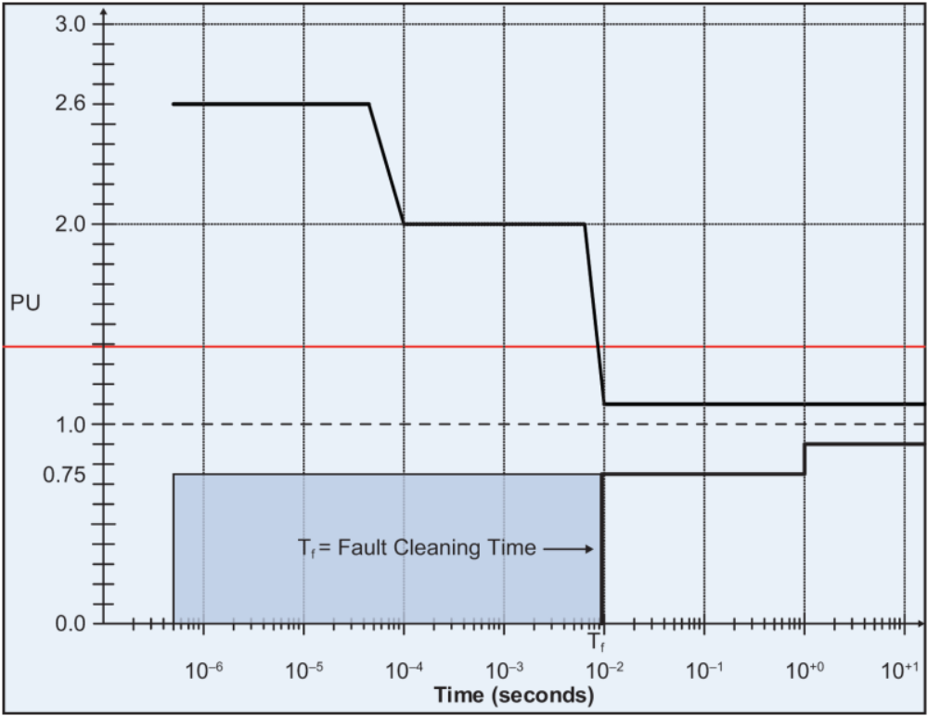
IEEE Std. 1709
IEEE Std 1709 DC Power (1 kV and above)
MVDC voltage tolerance
Also adds ripple requirement
  “The acceptable rms value of ripple voltage and load induced noise should not exceed 5% per unit.”

Slide 10
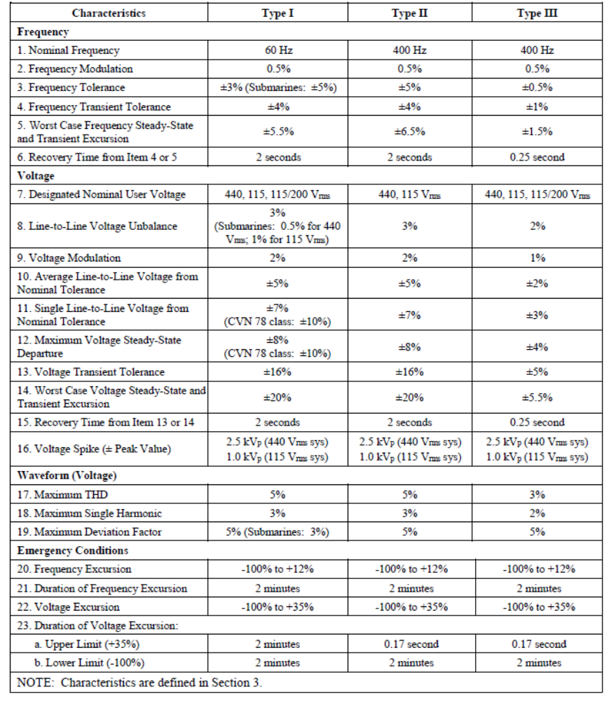
MIL-STD-1399-300-1
Low voltage ac
Provides definitions for every term
Provides additional guidance for load current waveforms
  Unbalance
  Power factor
  Ramp loads
  Pulsed loads

Slide 11
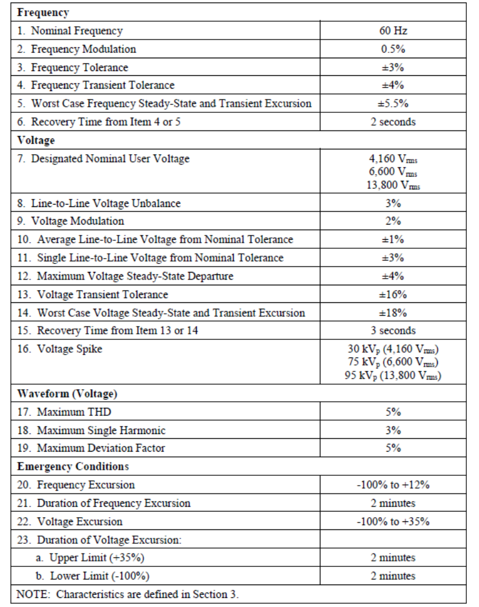
MIL-STD-1399-300-2
Medium voltage ac
Definitions consistent with MIL-STD-1399-300-1

Slide 12
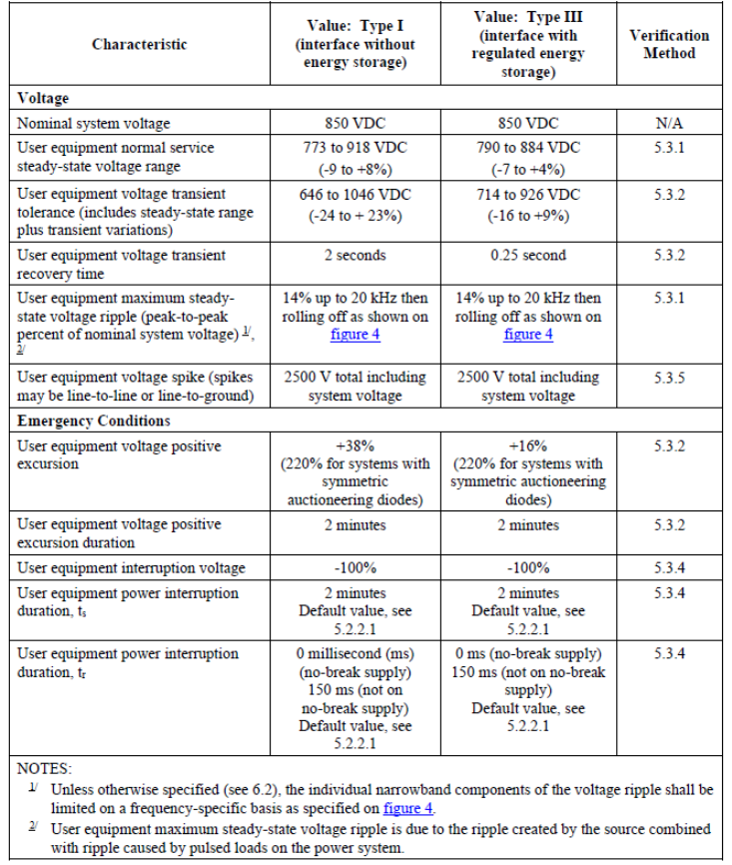
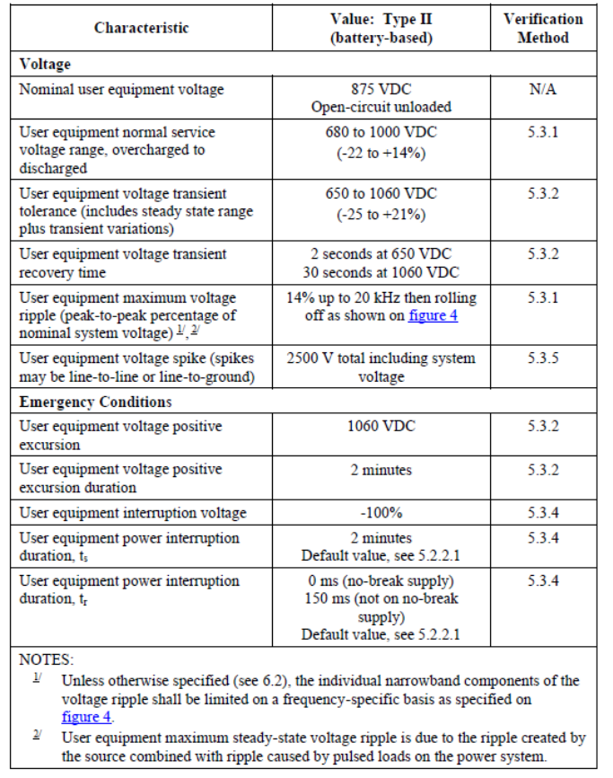
MIL-STD-1399-300-3
Low voltage dc
Provides definitions for every term
Provides additional requirements for current waveforms

Slide 13
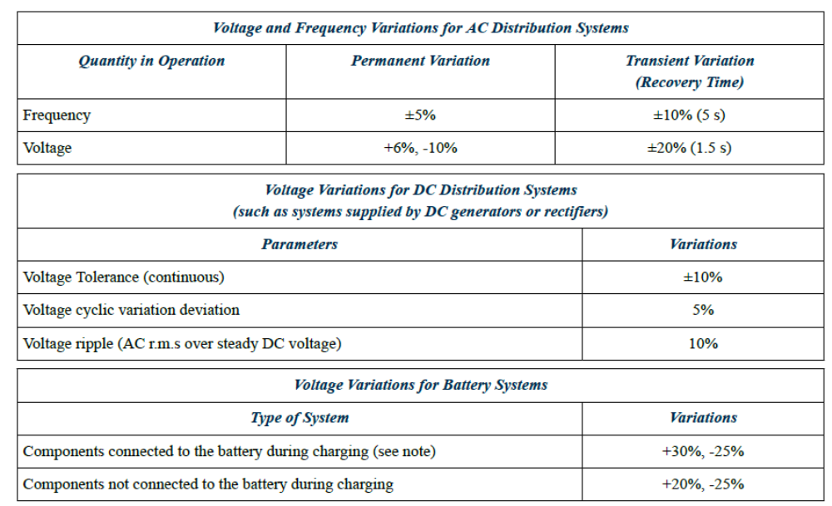
ABS Marine Vessel Rules (MVR)
Does not provide definition for terms

Slide 14
Quality of Service
Quality of Service is a reliability metric for the electrical power system
  Measured at the interface for each load
  Key metric is the Mean time between service interruption
  A Service interruption is a service disruption with duration greater than a load can tolerate
Service interruptions and disruptions are compared to two system metrics
  T1 = Reconfiguration time – based on choice of circuit protection
  T2 = Generator start time – based on choice of generator sets

Slide 15
Causes of service disruption
(service interruption)
Fault within user equipment causing voltage to fall below its minimum value before the applicable circuit breaker trips.
Generator sets tripping off line
Power distribution equipment failures

Slide 16
Quality of Service categories
Uninterruptible load
  Cannot tolerate service disruptions of duration t1
  Power system designed to minimize service disruptions
  Usually powered by an uninterruptible power supply (UPS)
Short-term interrupt load
  Can tolerate service disruptions of duration t1
  Cannot tolerate service disruptions of duration t2
  Power system designed to limit service disruptions to duration t1
Long-term interrupt load
  Can tolerate service disruptions of duration t2
  Power system designed to limit service disruptions to duration t2
Exempt load
  Subcategory of long-term interrupt load
  Need not be restored if surviving generation capacity is insufficient to power all loads

